Slide 1

Department of BES-II
BASIC ELECTRICAL & ELCTRONIC CIRCUITS (BEC)
COURSE CODE : 23EC1203
Topic:
traNsistor as a switch
Session – No.

Slide 2



AIM OF THE SESSION
To familiarize students with the basic concept of transistor as a switch
INSTRUCTIONAL OBJECTIVES
This Session is designed to:
Demonstrate the operating modes of transistor
Describe how transistor acts as switching element
List out the applications
Describe the significance of device in other operating regions
LEARNING OUTCOMES
At the end of this session, you should be able to:
Define transisor as a switch
Describe the operation
Summarize concept with applications

Slide 3
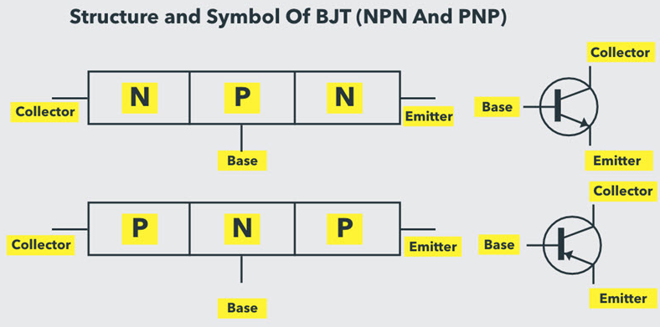
SESSION INTRODUCTION
There are two main families of Transistors: Bipolar Junction Transistors (BJT) and Field Effect Transistors (FETs).
The Bipolar Junction Transistor or simply BJT is a three-layer, three terminal and two junction semiconductor device. It consists of two PN Junctions coupled back-to-back with a common middle layer.
Whenever we say the term ‘transistor’, it often refers to BJT. It is a current controlled device, where the output current is controlled by the input current.
The name bipolar indicates that two types of charge carriers i.e., Electrons and Holes conduct current in the BJT, where holes are positive charge carriers and electrons are negative charge carriers.

Slide 4
Transistor types
The transistor has three regions, namely base, emitter and collector.
The emitter is a heavily doped terminal and emits electrons into the base.
Base terminal is lightly doped and passes the emitter-injected electrons on to the collector.
The collector terminal is moderately doped and collects electrons from base. This collector is large when compared to the other two regions so it can dissipate more heat.
BJTs are of two types: NPN and PNP. Both these function in the same way but they differ in terms of biasing and power supply polarity.
In PNP transistor, N-type material is sandwiched between two P-type materials whereas in case of NPN transistor P-type material is sandwiched between two N-type materials.

Slide 5
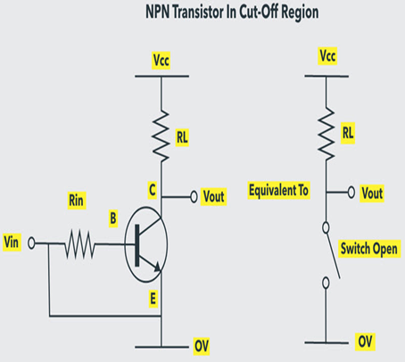
Operating Modes of Transistors
Depending on the biasing conditions like forward or reverse, transistors have three major modes of operation namely cutoff, active and saturation regions.
Cutoff Mode
In this mode, both collector base junction and emitter base junction are reverse biased. As both the PN Junctions are reverse biased,
there is almost no current flow except small leakage currents BJT in this mode is switched OFF and is essentially an open circuit.
Cutoff Region is primarily used in switching and digital logic circuits.

Slide 6

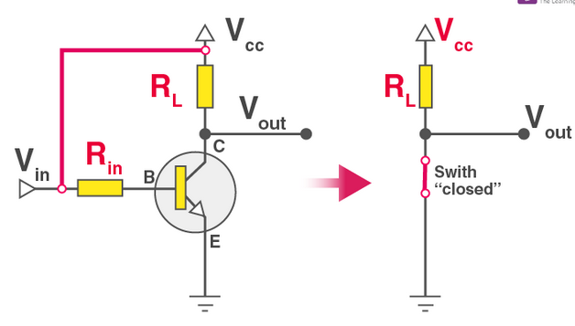
Transistor in saturation
In this mode or region,
the highest base current is applied, leading to the overall collector current.
causes the average collector-emitter voltage to fall and the leakage surface as small as possible
the maximum current that flows across this transistor.
Thus “Fully ON” transistor is triggered.

Slide 7
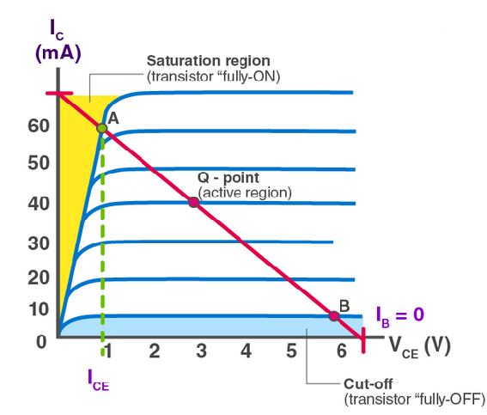
Output characteristics
Consider a base-biased transistor in a CE configuration.
When we extend the voltage rule of Kirchhoff to the circuit’s input and output side,
V_{BB} = I_{B}R_{B} + V_{BE} … (1)
V_{CE} = V_{CC} – I_{C}R_{C} … (2)
V_{BB} is the input voltage (Vi), and V_{CE} is the output voltage DC (Vo).
V_{i} = I_{B}R_{B} + V_{BE}
V_{o} = V_{CC} – I_{C}R_{C}

Slide 8
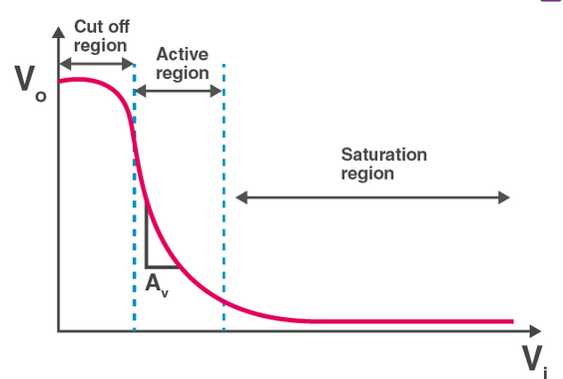
Applications OfTransistor as a Switch
The LED feature is the most widely employed practical application that is used as a switch for the transistor.
The relay operation can be managed by making the necessary circuit changes in order to connect and control some external devices with respect to the relay.
With this idea of transistors, the DC motors can be controlled and monitored.
used to turn the engine on and off. The motor speed can be modified by changing the transistor frequency values.
Light-bulb is one of the example of these switches’. It can switch the light on if the setting is bright and off, depending on the dark surroundings. A light-dependent resistor (LDR) is used to do this.
An element called a thermistor can be controlled using this switching method, which detects the ambient temperature.

Slide 9
SUMMARY
Transistor operating modes , characteristics , VI relationship is represented.
Student is able to identify the significance of transistor acts as a switch .
Student is able to verify the applications of transistor as a switch in real time projects

Slide 10
SELF-ASSESSMENT QUESTIONS
Which region of the transistor is very highly doped?
The base of the transistor is very highly doped.
… base of the transistor
… collector
… emitter of the transistor
….
…
…
…
…

Slide 11
TERMINAL QUESTIONS
1. Describe
2. List out
3. Analyze
4. Summarize

Slide 12
REFERENCES FOR FURTHER LEARNING OF THE SESSION
Reference Books:
1.
2.
3.
Sites and Web links:
1.
2.
3.

Slide 13
THANK YOU
Team – Fundamentals of IoT & Sensors

